Slide 1
IEEE sensors – student contest
Wifi bio AMPLifier

Slide 2
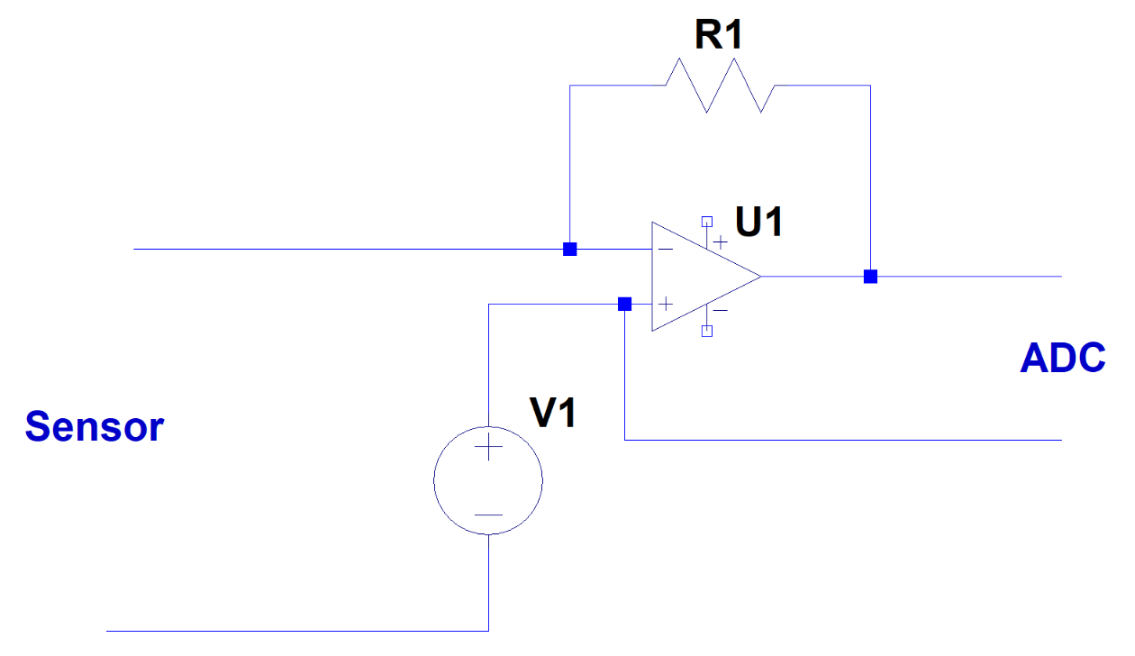
Resistance measurements
Schematic
Voltage source
Transimpedance amplifier
That’s it

Slide 3
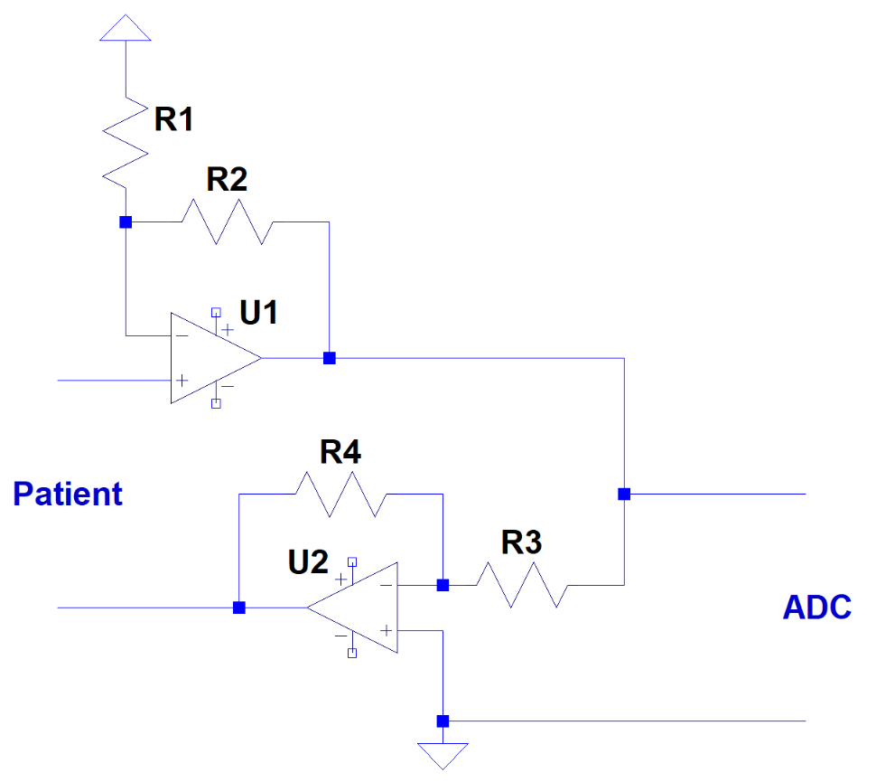
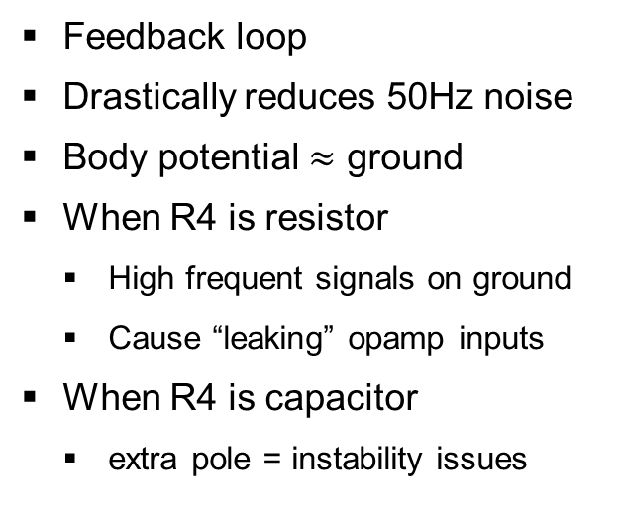
EMG amplifier
Driven right leg
Feedback loop
Drastically reduces 50Hz noise
Body potential $≈$ ground
When R4 is resistor
High frequent signals on ground
Cause “leaking” opamp inputs
When R4 is capacitor
extra pole = instability issues
Non-inverting
+
Non-inverting
Inverting
Body
inverting
0V
-

Slide 4
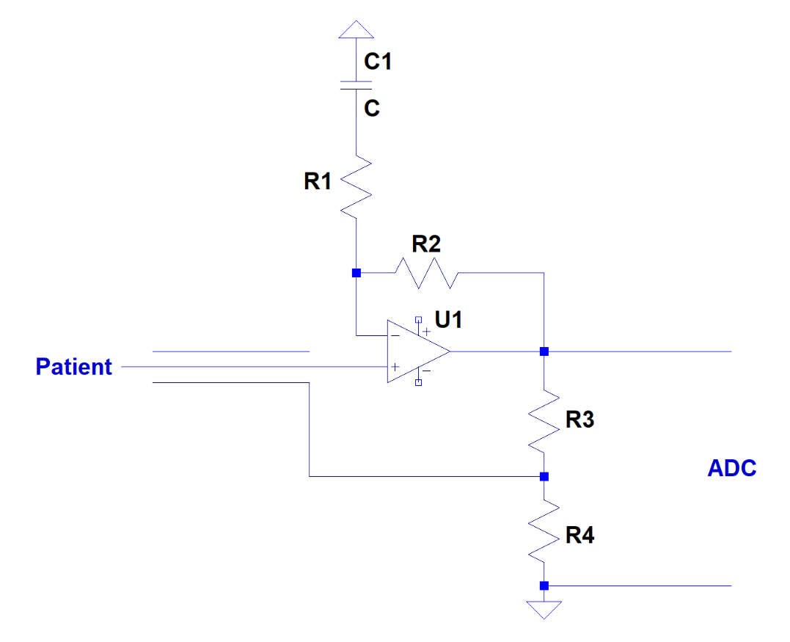
EMG amplifier
Amplifiers
Filters out DC
Allows a higher gain
Returns applied signal on shield
Cancels out wire capacitance

